Slide 1


Movie Night
Top best movies of all time

Slide 2

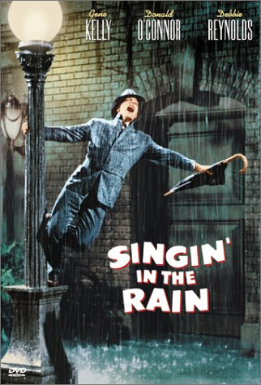

Web Scraping from imdb.com and BoxOfficemojo.com
We created a Beautifulsoup object and parsed with HTML_PARSE.
ITERABLE LIST OBTAINED WAS LOOPED TO OBTAIN MOVIE TITLES FOR BOTH WEBSITES

Slide 3


OMDBAPI TO MAKE API CALLS
USE OMDBAPI TO MAKE API CALLS FOR EACH OF THE TITLES FOUND
DATA OBTAINED AS A JSON
REMEMBER TO GIVE SOME TIME BETWEEN REQUESTS : time.sleep(2)
IF TITLE NAME HAS SPACES, when you request USE url=url.replace(" ","+") IN THE LOOP
Hide your key in congif.py

Slide 4
Insert data in Mongodb
Initialize pymongo to work with Mongodb
Define database and collection
Create dictionary to be inserted as mongobd document

Slide 5



Credits
Benedict Waiharo
Guisha Ceus
Deborah Ofsievich

